Slide 1
Model View Controller (MVC) Design Pattern
Crystal Tenn
Crystal.Tenn@microsoft.com

Slide 2
What is the MVC design pattern?

Slide 3
What is the Model View Controller (MVC) design pattern?
Controller
1. User action via view
2. Request model to change
5. Updated model state
4. Updated model state
View
Model
6. Updates UI component(s) to reflect updated model state
3. Model updates in response to controller request

Slide 4
MVC Workflow
A way of separating model and view
User interacts with the view
View events (e.g. button click) invoke methods on Controller
Controller acts on model according to action from the View
Model reacts and changes its state in response to Controller’s action on it
Controller notices model’s new state
Controller sends the model’s new state to the view
The view updates itself in response to the model’s new state

Slide 5
What is the Model View Controller (MVC) design pattern?
A way of separating model and view
Model capture business objects’ state and behaviours
View merely renders a given model state
Controller mediates between the view and model to allow the model to react to the user’s actions via the view, and allow the view to respond to the model’s changing state.
Notes:
A way of separating model and view
Uses observer pattern
View observes Controller – when the controller changes, the view is notified.
Controller observes Model – when the model changes, the controller is notified.
Model is unaware of the View and Controller
Controller is unaware of the View
Steps:
User interacts with view element (e.g. clicks a button)
View calls controller with what action was invoked by the user.
The controller acts on the model depending on the action.
The model reacts by changing its state according to its object oriented relationships (essentially data/fields + behaviours/methods)
The controller obtains the changed state of the model
The controller tells all its listeners about the change
The view is one such listener and hears about the change
The view then updates itself to reflect the change

Slide 6
What are the benefits of MVC?

Slide 7
What are the benefits of MVC?
Separation of concerns
Between view and model
A fundamental software engineering principle
Code that is
Easier to test
Easier to maintain
Easier to plug model into different views (e.g. for different clients like web vs. mobile)

Slide 8
Model View Presenter (MVP) Design Pattern
Crystal Tenn
Crystal.Tenn@microsoft.com

Slide 9
What is the MVP design pattern?

Slide 10
What is the Model View Presenter (MVP) design pattern?
User interacts with view elements e.g. by clicking a button
The (e.g.) button’s click handler will do nothing but invoke a method of the presenter that has no parameters and no return value.
The presenter then retrieves data from the view (e.g. what the user entered in a textbox) through methods defined by the view interface.
Presenter then uses this user-entered data from the view, and acts on the model causing a state change in the model. (The model has business state and behaviours.)
The presenter then looks at the updated model state and sends only relevant changes to the view it is responsible for.
The view then changes how it looks (e.g. set a label text) in response to the change communicated to it by the presenter.
Notes:
Note:
The model in MVP is oblivious to the existence of a view or a presenter. It simply captures state and behaviour logic. It does not care who is using it for what purposes.

Slide 11
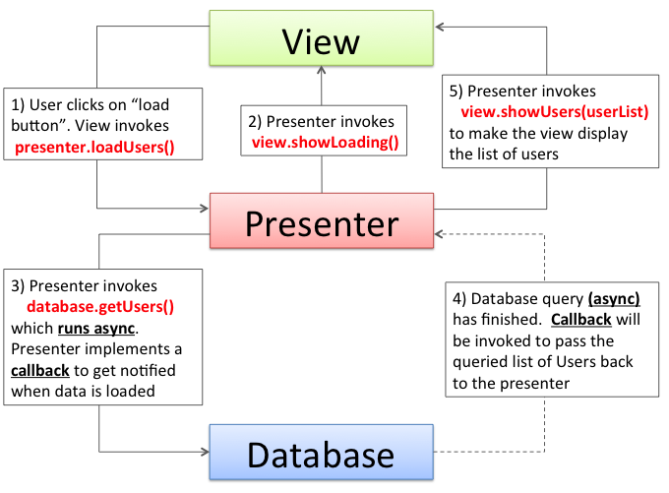
MVP

Slide 12
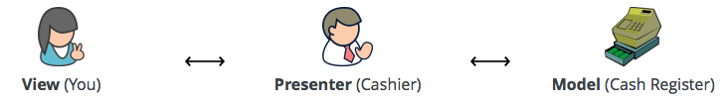
Model View Presenter Web Forms Framework
The simplest way to explain the pattern is to consider a checkout at a supermarket.
Visualise that you, the customer, are the View, the cashier is the Presenter and the cash register is the Model.
Example Reference: http://www.bradoncode.com/blog/2012/04/mvp-design-pattern-survival-kit.html
Notes:
https://github.com/webformsmvp/webformsmvp

Slide 13
Model View Presenter Web Forms Framework
Key point: The view will never access the model directly.
Key point: We need to be able to replace the View without having to change the Presenter.
Key point: The Presenter will make all the decisions about interactions and the Model will make the business logic decisions.
Example Reference: http://www.bradoncode.com/blog/2012/04/mvp-design-pattern-survival-kit.html
Notes:
When it’s time to pay for your goods would you, the customer (View), reach over the counter and put your money into the cash register (Model) directly? No, you would hand your money to the cashier (Presenter) and they would make the necessary amendments to the cash register by depositing your money and taking money out to give change where necessary. You would never have direct access to the cash register.
Once you have paid for your items you will leave the store and it’s likely that the next customer will pay for their items and the same cashier will process the transaction. The point being that the customer may change but the cashier will remain the same and can still conduct the transaction even with a different customer without having to be re-trained to serve that customer. The customer can change but the cashier doesn’t have to.
Imagine if the customer was responsible for deciding whether or not they were eligible for a discount based on the goods they wish to buy? If this were the case the customer would need to be trained how to do this, then the next customer and so on. This would never happen. The likely scenario is the cashier would scan all of the items and the cash register would compute whether a discount was applicable. Logic is never the responsibility of the customer and in many cases not the responsibility of the cashier.

Slide 14
What are the benefits of MVP?

Slide 15
What are the benefits of MVP?
View layer decoupled from the model (separation of concerns)
Easier to maintain
Easier to test
Easier to replace/refactor
No more code behind page!!!

Slide 16
Thank you!

